Slide 1

Web Service Intro
www.pragmatic.bg
Lector: Dimitar Topuzov
E-mail: dtopuzov@gmail.com
LinkedIn: http://bg.linkedin.com/pub/dimitar-topuzov/18/470/833/en
Copyright © Pragmatic LLC 2015

Slide 2
Content
What is Web Service
Web Service Concepts
Why Web Services
Multitier Software Architectures
Web Services in context of Multitier Software Systems
The place of Web Services in such systems
Testing Web Services
Why we test Web Services
Types of tests we can perform

Slide 3
What is a Service
In the real world a "service" is:
A piece of work performed by a service provider
Provides a client (consumer) some desired result by some input parameters
Has quality characteristics (price, execution time, constraints, etc.)

Slide 4
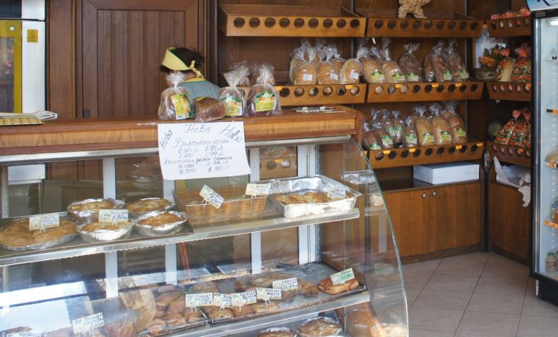
Example

Slide 5
What is a Web Service
Web services are services that can be accessed over a network
Takes some input, do some work and produces some output
Request-Response model: Client request, server responses
Notes:
Web services are services that can be accessed over a network, for instance via the global internet. Often these web services and their clients communicate via web protocols like HTTP.

Slide 6
What is a Web Service
“ A software system designed to support interoperable machine-to-machine interaction over a network… "
W3C definition

Slide 7
..in Bulgarian Please
“Уеб услугата представлява софтуерна система, която предоставя комуникация между взаимносъвместими компютърни системи по компютърни мрежи"
W3C definition
Translated in Bulgarian By Wikipedia

Slide 8
IBM Definition
"Web services are self-describing, self-contained, modular applications that can be mixed and matched with other Web services to create innovative products, processes and value chains. Web services are Internet applications that fulfill a specific task or a set of tasks that work with many other Web services in an interoperable manner to carry out their part of a complex work flow or a business transaction."

Slide 9
Sun Microsystems Definition
"A Web service describes specific business functionality exposed by a company, usually through an Internet connection, for the purpose of providing a way for another company or software program to use the service."

Slide 10
Microsoft Definition
"A Web service is a unit of application logic providing data and services to other applications. Applications access Web services via ubiquitous Web protocols and data formats such as HTTP, XML, and SOAP, with no need to worry about how each Web service is implemented. Web services combine the best aspects of component-based development and the Web."

Slide 11
Conclusion
Definitions above are different, but one thing is sure – Three of the major players in the industry are talking positively about the same technology
This in itself means the idea of Web Services is worth
All proprietary technologies of those companies (like Microsoft Common Object Model (COM) for example) are dead and Web Services are here to stay

Slide 12
Web Service Concepts
Communication through standard protocols
HTTP, FTP, SMTP (for transport)
XML, JSON, RSS (for data)
Autonomous
Each service operates autonomous without aware that other services exists
Stateless
Do not remember a durable state between requests

Slide 13
Stateless Example
Notes:
Statefull:
- Купувам нещо, но не ми достигат парите и Кака Наска помни, че имам да и давам 20лв.
- Следвъщия път Кака Наска помни стейта и ми прихваща 20лв
Stateless:
- Плащам си всичко, при следваща покупка Кака Наска не трябва да помни предните.

Slide 14
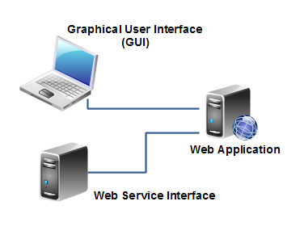
Web Services vs. Websites
Web application are designed to be accessed by humans via Web Client.
Web services are intended to be used by machine (other software).
Notes:
The main difference between a web service and a web site is, that a web site is typically intended for human consumption (human-to-computer interaction), whereas web services are typically intended for computer-to-computer interaction.
Of course this distinction is somewhat blurred. A web application can contain both a graphical user interface for human users, as well as a set of web services for computer "users" (clients). For instance, a payment service like Paypal has both a graphical user interface for human users, as well as a set of web services through which you can have your own backend systems access the Paypal services.
This illustration shows a web application that contains both a graphical user interface, and a web service interface (a set of web services exposing selected functions of the web application):

Slide 15
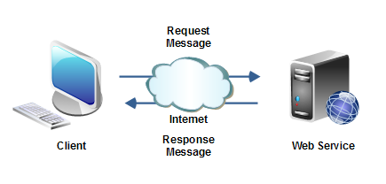
Web Service and Client
.NET Web Application
Weather service implemented in Java
Runs on Window
Runs on Linux

Slide 16
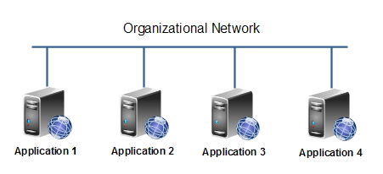
Why Web Services
Connect existing software
Web services help solve the interoperability problem
Giving different applications a way to link their data
Using Web services you can exchange data between different applications and different platforms

Slide 17
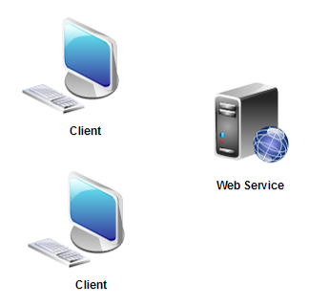
Why Web Services
Reuse application components
Ideally, there will only be one type of each application component, and anyone can use it in their application

Slide 18
Monolithic Apps
Web
Android
iOS
App
App
App
DB Layer
DB Layer
DB Layer

Slide 19
Multitier Architecture
Web
Android
iOS
UI Layer
UI Layer
UI Layer
Service Layer
DB Layer

Slide 20
Multitier Architecture
UI Layer
Presentation
Service Layer
Business logic
DB Layer
Data storage

Slide 21

Testing Service Layer
Benefits:
Good way to test business logic
Faster tests
Less fragile
Lower Maintenance
Disadvantages:
Not testing what user actually use and see
UI Layer
Service Layer
DB Layer

Slide 22
Functional Testing
Based on tools
Due to the fact that web services are intended to be consumed by machines it is hard a human to consume and test them directly
We can test
If response message is in correct format
If response message has correct data
If status code of response message is correct

Slide 23
Performance Testing
Based on tools
Same as testing Web or other software performance can’t be measured with out tools
We can test performance in terms of
Time web service need to do the actual work and return a response
Time between sending a request and receiving a response (including time for transfer over the network)

Slide 24
Load Testing
Based on tools
It is hard to simulate a lot of simultaneous users without tools
Test the performance under load of X simultaneous clients
We can measure the same metric as those we measure during performance testing
Monitor the servers during load testing is must!
Memory usage
CPU usage
Disk I/O operations

Slide 25
Security Testing
In order to test Security we can test
Authentication
Message Confidentiality
Data elements meant to be kept confidential must be encrypted
Content Validation
Web services need to validate input before consuming it
XML Denial of Service Protection
Validation against recursive payloads
Validation against oversized payloads

Slide 26
Usability Testing
We can not test usability in terms of “how it looks”, but we still can test if it is easy to perform some operation or get data via Web Service.

Slide 27
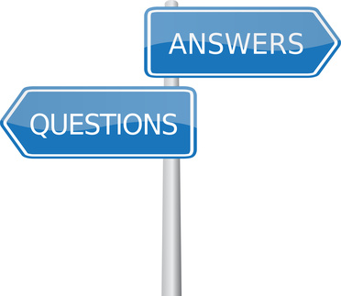
Questions

